Slide 1

Ruchira Application for Selling Home made products
Group No. 21
Sakshi jain(17104041)
Anuja Apte(17104029)
Mayuri Deshpande(17104062)
Project Guide: Ganesh Gourshete

Slide 2
Contents
Abstract
Introduction
Objectives
Literature Review
Problem Definition
Existing System Architecture/Working
Proposed System Architecture/Working
Conclusion
References
Publication

Slide 3
Abstract
Self-employed women who manage business of Homemade spices,snacks,beauty products etc . These women are not able to reach consumers . Their sales and marketing activities are restricted to mouth publicity and experience . So we are deciding to make a web application such that these self employed women can sell their products using these app.This study aims to determine the factors that motivate women entrepreneurship through online business.To obtain convenience , comfort and increase precise in living and living life and modern life, humans always needs products that are better quality or new products from the business world .Women are listed as among the most widely used online business. So the results show that there are 7 factors in motivating women entrepreneurship through online business namely ,Experience and facility Factor ,self Actualization Factor , Reward and Opportunity Factor , Individual Potential factor , Family Factor , Unemployment factor.

Slide 4
Introduction
Being stay at home woman, have a unique skills which can be made at home and sell online by making a ecommerce website one of the best ways to make money at home is by starting an Online store .
The web Development of dynamic science and Technology , continues to show progress so rapidly in all aspects of life. Included in business relate to human needs that are dynamic . These dynamics nature is caused by business related to human needs which are also dynamic.
Online entrepreneurship is the process of starting a business by promoting innovation and taking all risks.
Through these web application a women who made home made products, will be able to sell it online by starting a online business.
Every women has the ability to start the business but they doesn’t have that much confidence to start business online. Every women has a entrepreneur spirit which means having creativity and having a specific purpose and trying to achieve success in her life.

Slide 5
Objective
If you plan to establish an online presence for your online business ,you have to consider the objectives and the main purpose for your new website.
Every Element and detail of your page should mirror the objectives . The major objectives that a business plan looks to achieve include the Following elements.
1.To Build a Cross-platform Application.
2.To Build the Mobile Friendly User Interface.
3.To have a Multi-Lingual Support in Application.
Functionalities:
Promoting a service or product online.
Selling a service or product.
Providing product support or customer service.
Providing corporate information.
Dedicating enough time for planning
Gauging business strategy and applying due correction
Arranging Financial resources
Marketing Analysis

Slide 6
Literature Review
Paper Title: Study of Handicraft Marketing Strategies of Artisans in Uttar Pradesh and Its Implication
Author: Waqar Ahmad Khan1 and Zeeshan Amir
Publication Details : Research Scholar, Faculty of Management and Research, Integral University, Lucknow, U.P., INDIA 2Dean, FMR, Integral University, Lucknow, U.P., INDIA , 21/12 18th December 2012
Findings : This research paper is based on the secondary data by exploring various secondary data resources such as old research papers various journals, books internet, some of the governmental data etc. The Design of a handicraft product should be in accordance with the tastes and preferences of customers. Expansion is increasing the present scale of operation either by mechanizing the process of production or by enhancing tile installed capacity.
Advantages: Channel agents, such as middlemen, retailer or distributor try to capitalize on such possibilities and earn significant profit almost wholly at the cost of the craftsmen. Handicraft product may be categorized on the basis of price, export on domestic market, ease of maintenance, ease of storage, utility value or decorative value and modernity or traditional orientation.

Slide 7
Problem Definition
Now a days women are not able to reach their products to the consumers. Hence, we are making an application for women so that they can sell their products online.
Due to some family issues like family not allowing women to go out for work, their products are not reachable to consumers.To avoid this kind of difficulty we are developing a social platform using ecommerce so that all the women can work accordingly by staying at home.
There is an existing web application we are recreating it adding additional features in our project like language option then audio option.

Slide 8
Existing System Architecture
RUCHIRA APPLICATION
REGISTER
LOGIN
FACILITIES
MOST PURCHASED
HOME
BUYER
SELLER
ADMIN
AUTOMOBILES
BEAUTY PARLOUR
CATERINGS
OTHERS
FOOD
CLOTH-ING
JWELLERY

Slide 9
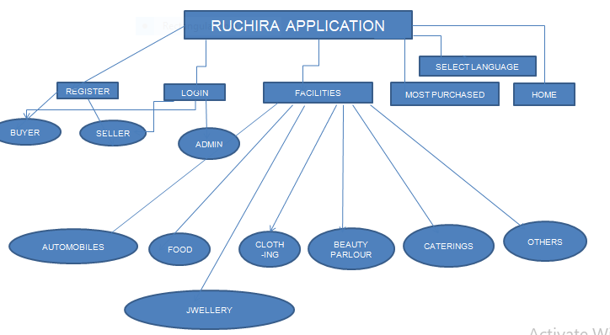
Proposed System Architecture

Slide 10
Google Translator
Google Cloud Translation API implements Machine Learning concept to translate from one language to other supporting languages. This is highly responsive and known for its ease of use so that applications can integrate with Translation API for fast and dynamic translation of source language to the target language.
Speech API
Translate API
Natural Languages API

Slide 11
Geolocation API
The Geolocation API returns a location and accuracy radius based on information about cell towers and WiFi nodes that the mobile client can detect. This document describes the protocol used to send this data to the server and to return a response to the client.
Request body
Cell tower objects
WiFi access point objects
Geolocation responses
Errors

Slide 12
Payment Gateways
PayPal
Amazon pay
Paytm
Credit
Debit
Net Banking
COD

Slide 13
Technological Stack Html (front end) Php(frontend) React(front end) Mysql(Database) Bootstrap(Mobile friendly GUI) Flutter(GUI) Natural Language Processing(NLP)

Slide 14
Conclusion
The Internet has opened so many opportunities for doing business online, and ecommerce is one of the most popular ones. Not only does it require low investment ,it actually is a type of business that does not require a full time commitment , especially if you are selling limited no of products. You just make an online presence and promote the business here and there using both free and paid methods.
However as each business has its positive and negative sides. If you want to achieve success ,you will have to create an organized strategy which is based on realistic goals and comprehensive analysis of the market.

Slide 15
References
Prajapati and Laila, Development of Handloom Industry, Deep & Deep, New Delhi (1981) .
Thaimani, K. K., Handicrafts during seventh five year plan., paper presented in National Seminar on development and management of Handicrafts cooperative 24-26th November, VAMNICOM (1987) .
Dak,T.M., Rural Industralistation: Challenges and Responses, North Book, Delhi, pp-23-24 (1989) .
Florence, K., Uganda Handicrafts Export Strategy, ITC Report, WTO (2005) .
Resource Center RCIP, Euro zone crises to hamper leather industry, http://www.fddiindia.com/publications/newsletter/2010/006June/FDDINL_264_25.06.2010.pdf, (2010) .
Sanyal, S., Banerjee, S. and Majumder, S., India’s Leather in the World Market: Exploration of Recent Trends, Trade and Development Review 3 (1), 22 – 58 (2010) .
Kotler, P., Marketing Management, Thomson Press (India) Ltd, New Delhi, (2003)

Slide 16
Thank You.!

